Slide 1
3D Image Segmentation and Quantification of Lysosomes
Comparison manual.VS. automatic
4/12/2025

Slide 2
FILES
TMEM-HA 6h CB airy_3_170722
40A_UAS-TMEM192-3xHA x 40A 71G10 MARCM_around 12h - for quantification_4 Airy-CBs_300425
40A_UAS-TMEM192-3xHA x 40A 71G10 MARCM_around 12h - for quantification_3 Airy-CBs_300425
40A_UAS-TMEM1923x-HA x 71G10 40A MARCM_L3_1_Airy_010724

Slide 3
TMEM-HA 6h CB airy_3_170722

Slide 4
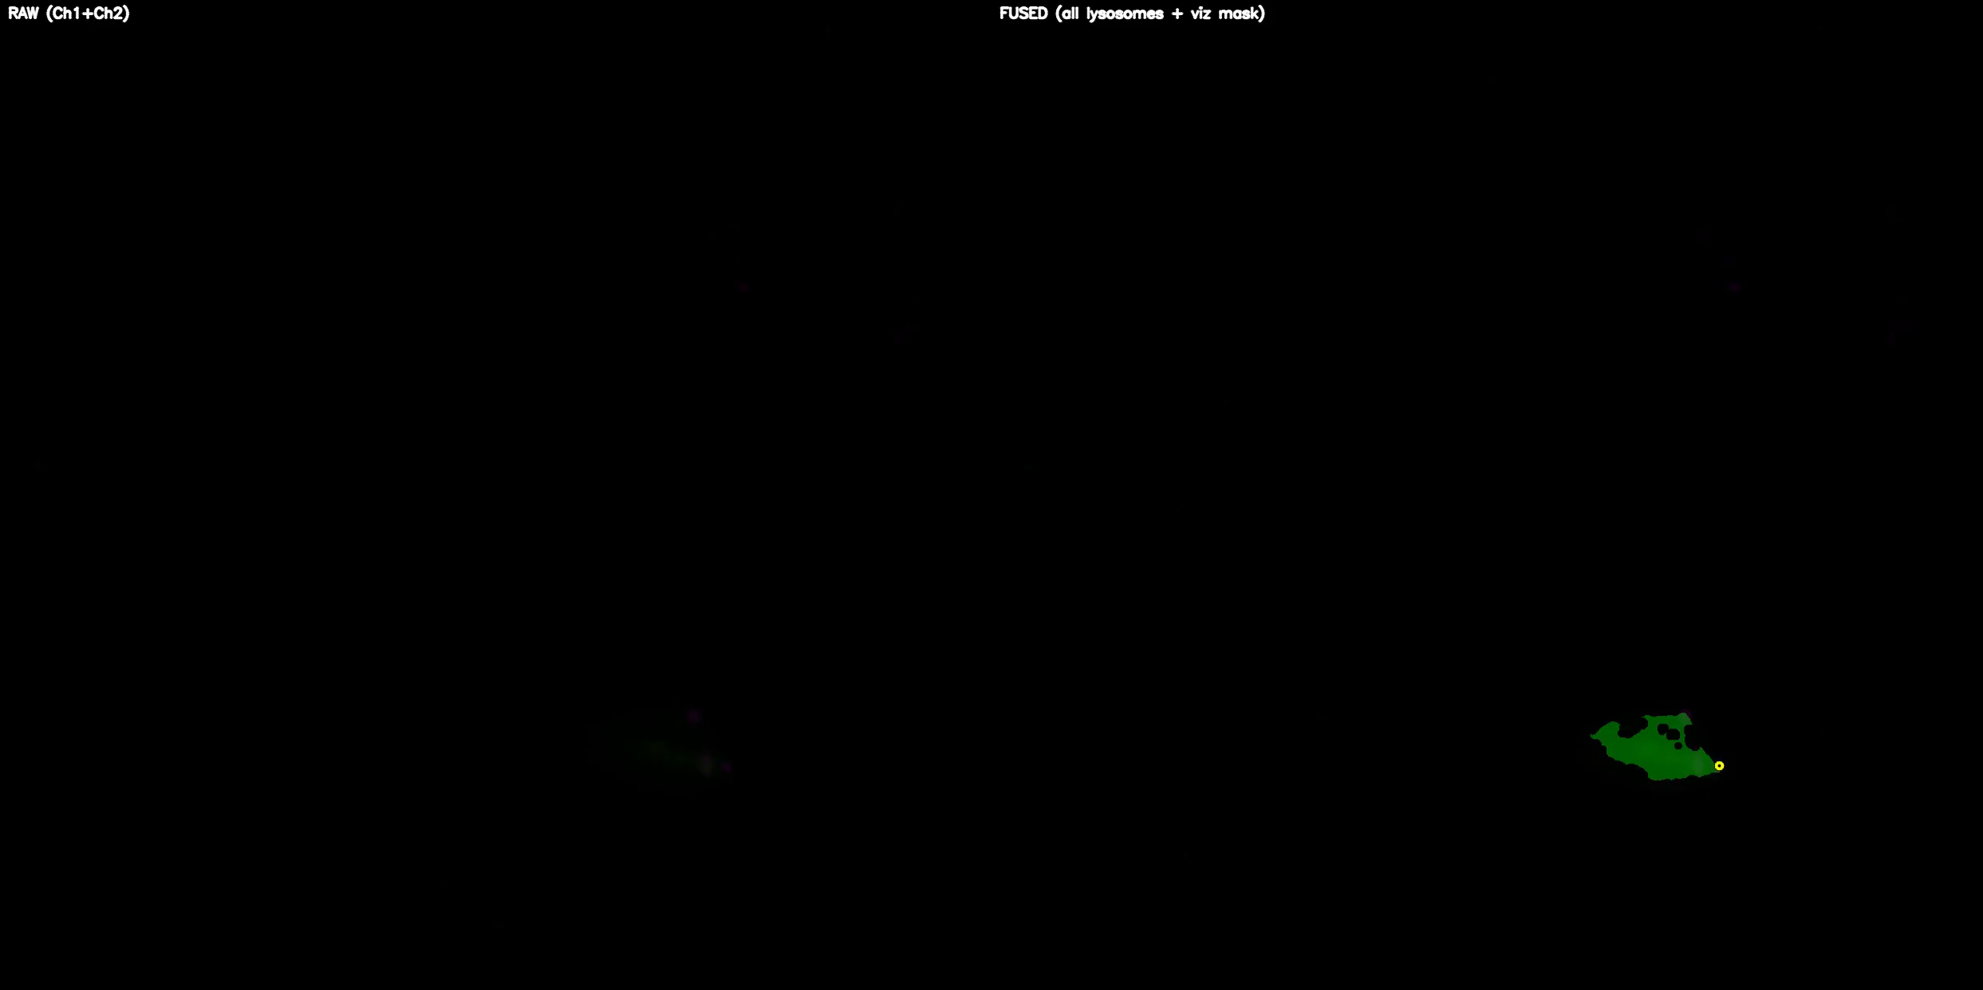
DETECTION VIDEO

Slide 5
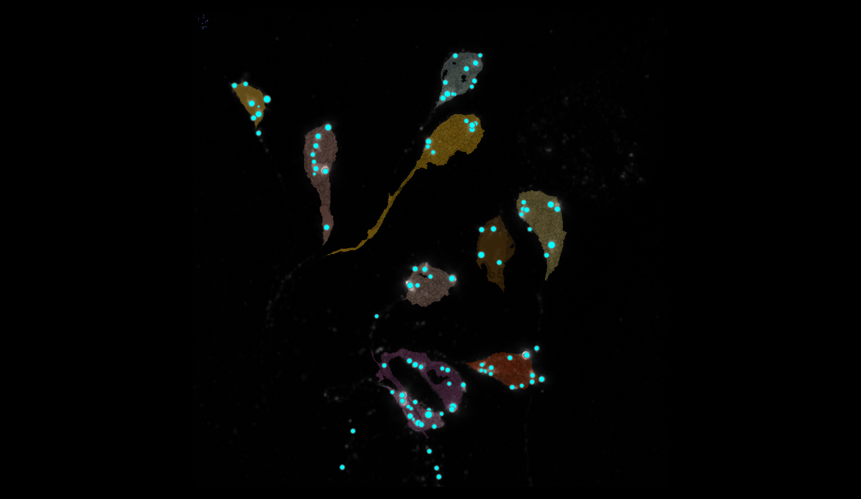
SEGMENTATION
24
2
9
8
6
7
15
1
3
5

Slide 6
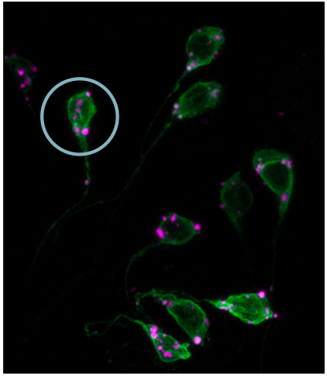
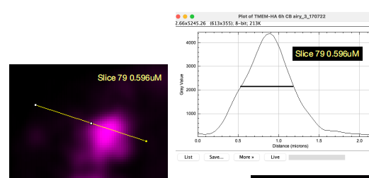
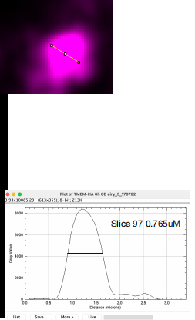
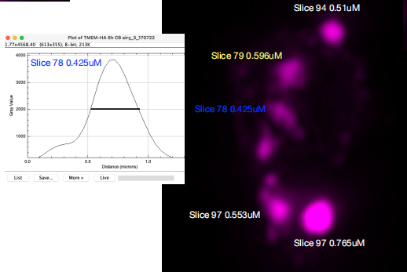
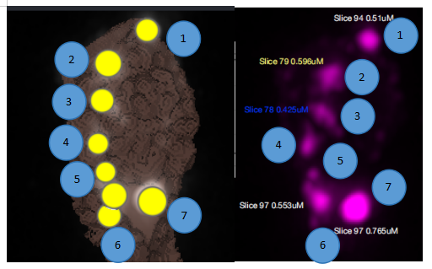
MANUAL.vs.AUTOMATIC

Slide 7
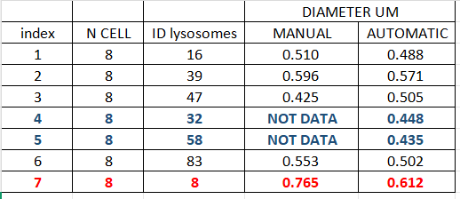
MANUAL.vs.AUTOMATIC

Slide 8
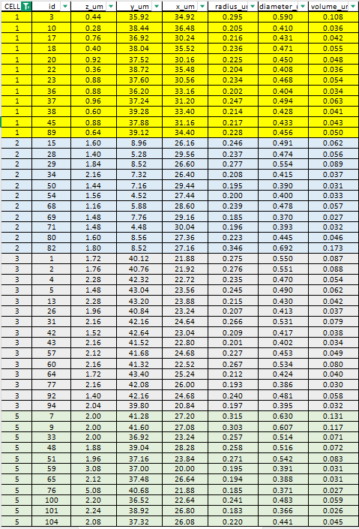
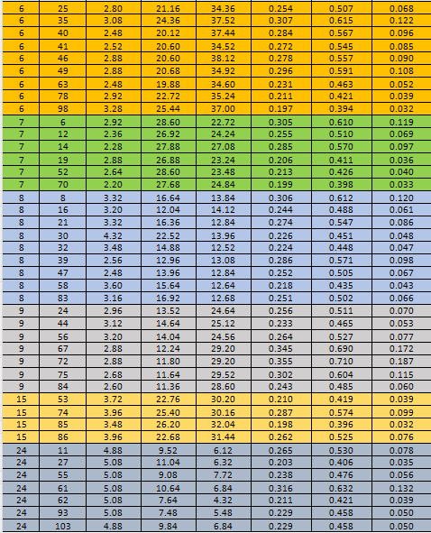
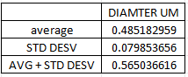
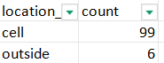
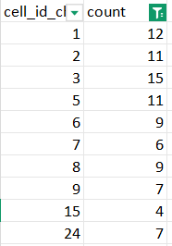
DATASET LYSOSOMES(ORDER FOR CELL ID)

Slide 9
40A_UAS-TMEM192-3xHA x 40A 71G10 MARCM_around 12h - for quantification_4 Airy-CBs_300425

Slide 10
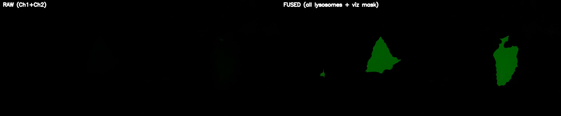
DETECTION VIDEO

Slide 11
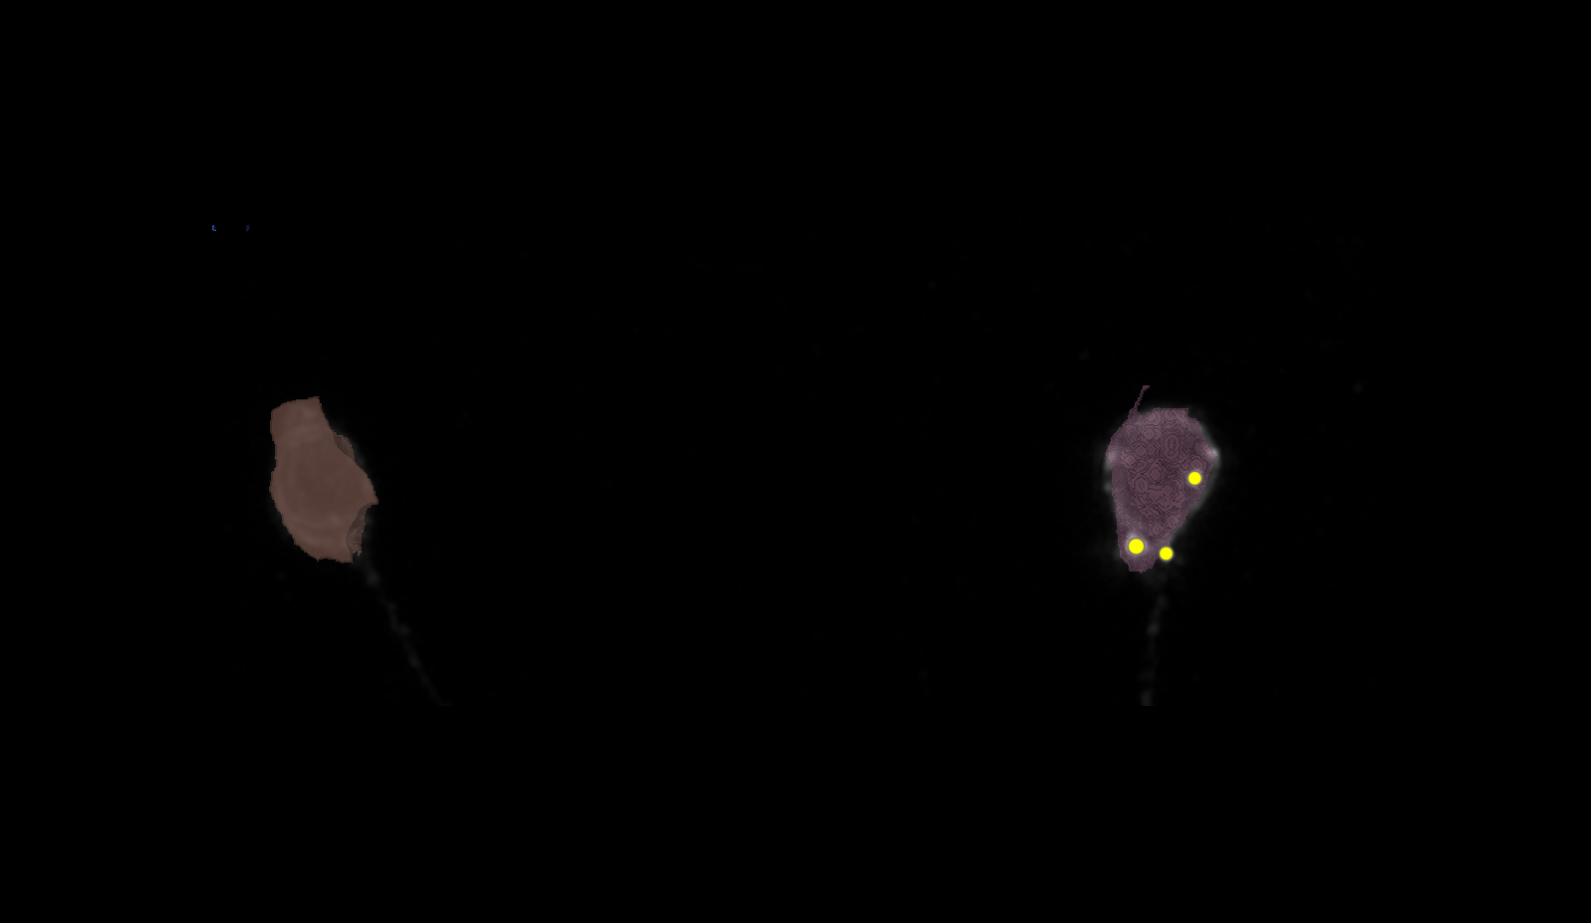
SEGMENTATION

Slide 12
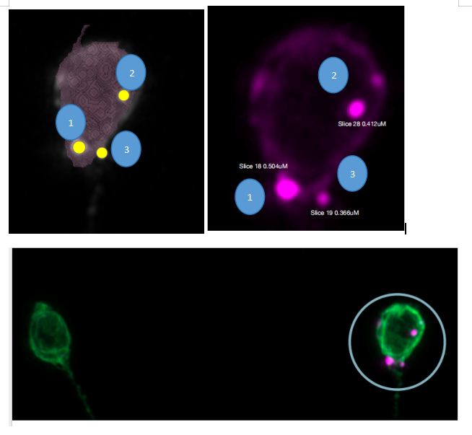
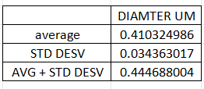
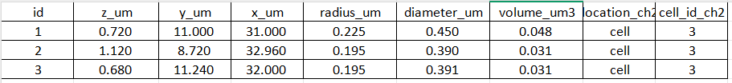
MANUAL.vs.AUTOMATIC + DATASET LYSOSOMES
1 CELL, 3 LYSOSOMES
N CELL | ID LYSOSOMES | MANUAL DIAMETER UM | AUTOMATIC DIAMETER UM
3 | 1 | 0.504 | 0.45
3 | 2 | 0.412 | 0.39
3 | 3 | 0.366 | 0.391

Slide 13
40A_UAS-TMEM192-3xHA x 40A 71G10 MARCM_around 12h - for quantification_3 Airy-CBs_300425

Slide 14
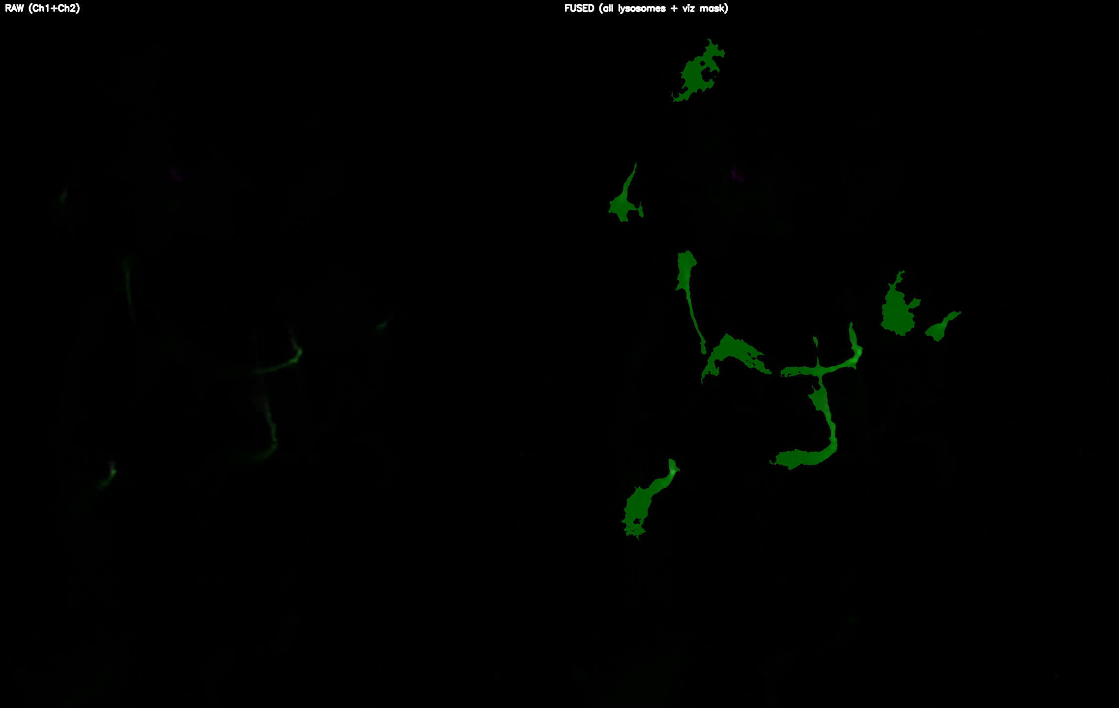
DETECTION VIDEO

Slide 15
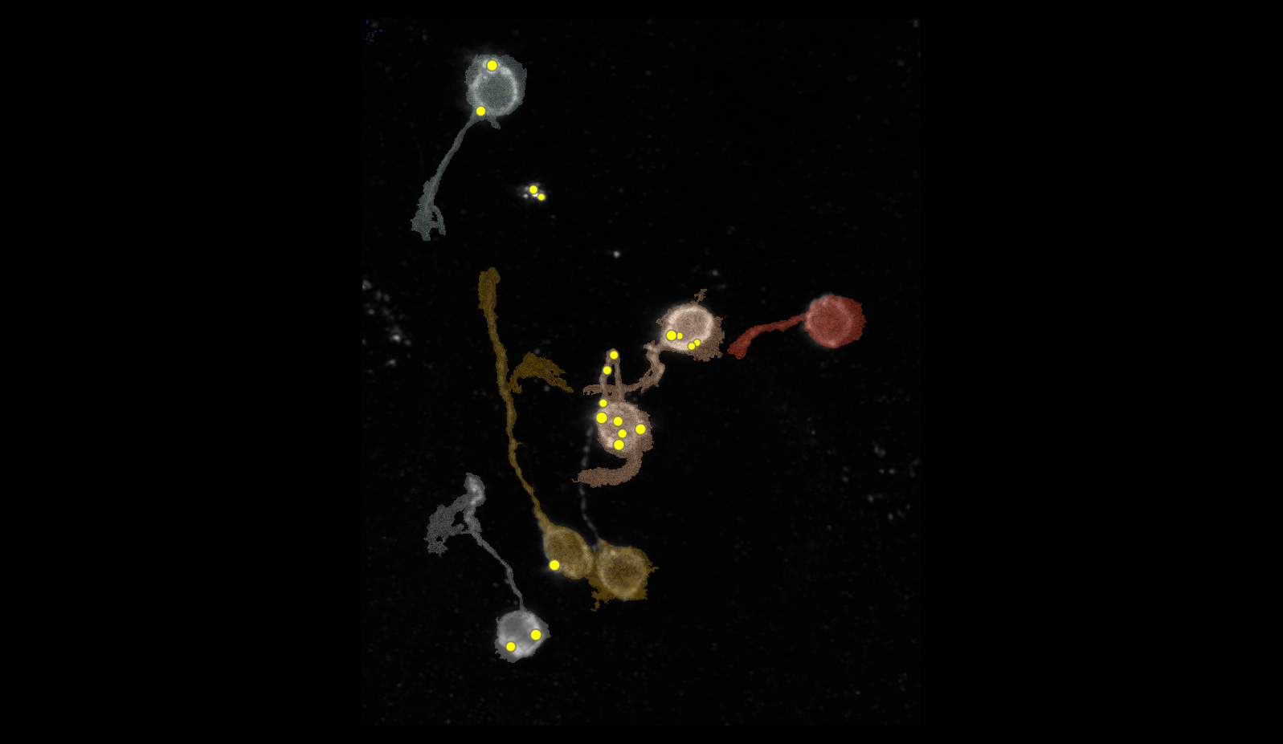
SEGMENTATION
2
9
25
121
141

Slide 16
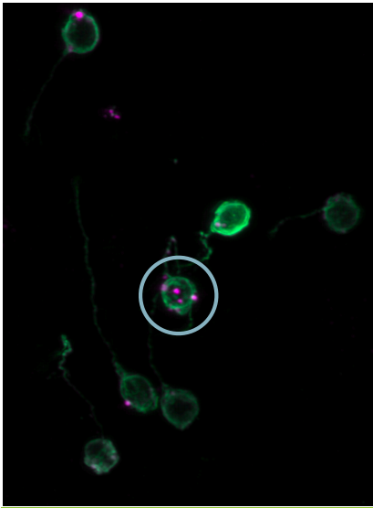
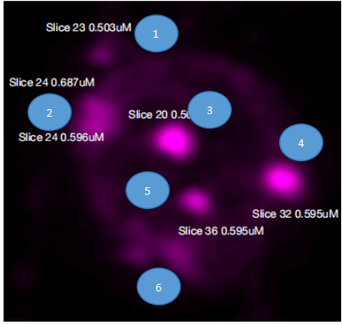
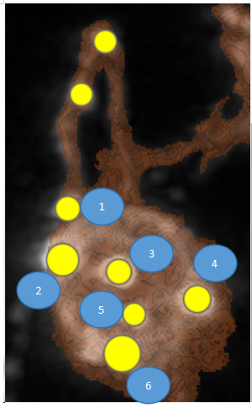
MANUAL.vs.AUTOMATIC

Slide 17
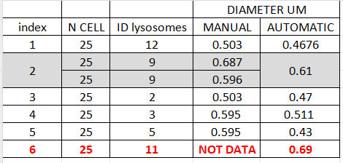
MANUAL.vs.AUTOMATIC

Slide 18
DATASETS

Slide 19
40A_UAS-TMEM1923x-HA x 71G10 40A MARCM_L3_1_Airy_010724

Slide 20
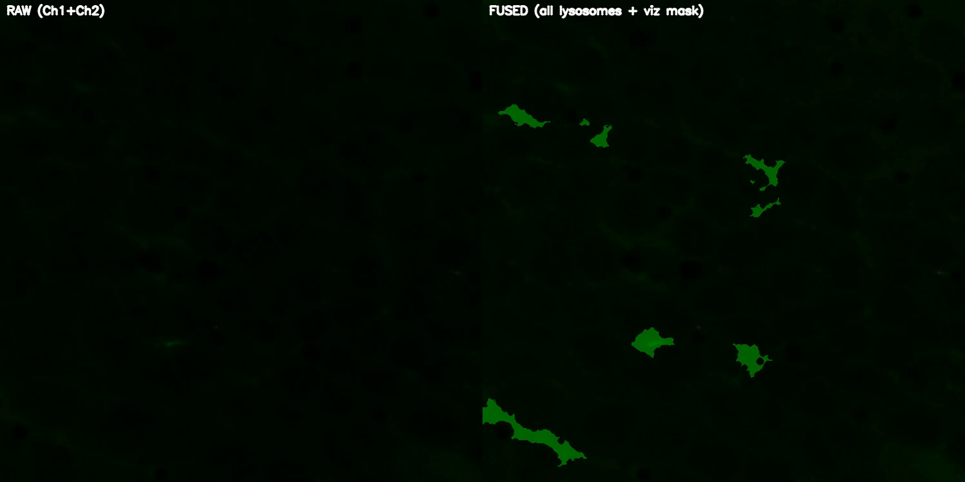
40A_UAS-TMEM1923x-HA x 71G10 40A MARCM_L3_1_Airy_010724

Slide 21
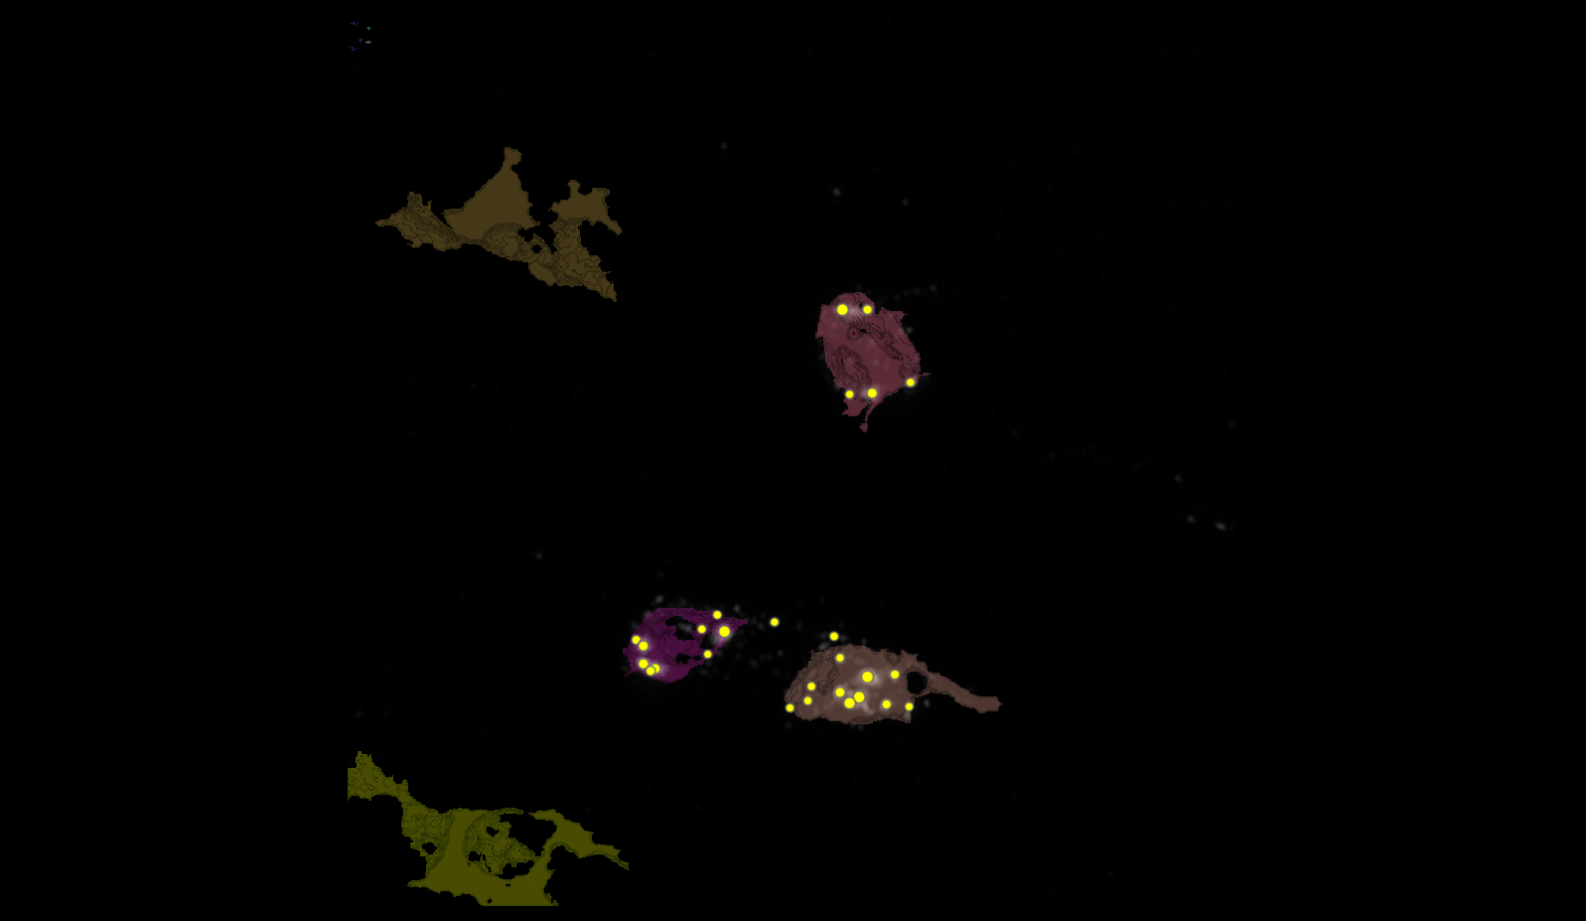
40A_UAS-TMEM1923x-HA x 71G10 40A MARCM_L3_1_Airy_010724
78
151
148
155

Slide 22
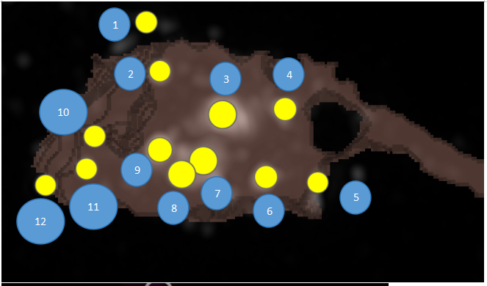
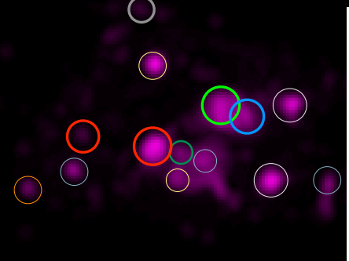
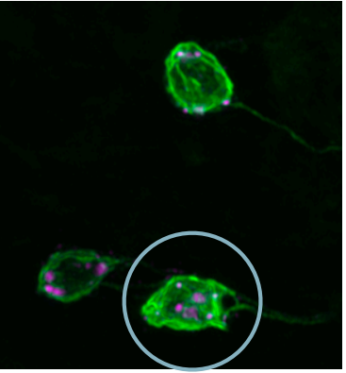
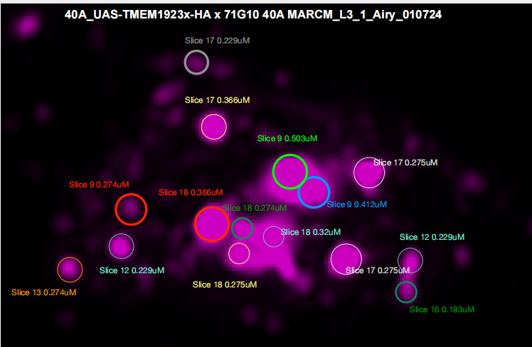
40A_UAS-TMEM1923x-HA x 71G10 40A MARCM_L3_1_Airy_010724
1
3
2
4
10
9
7
11
12
8
6
5

Slide 23
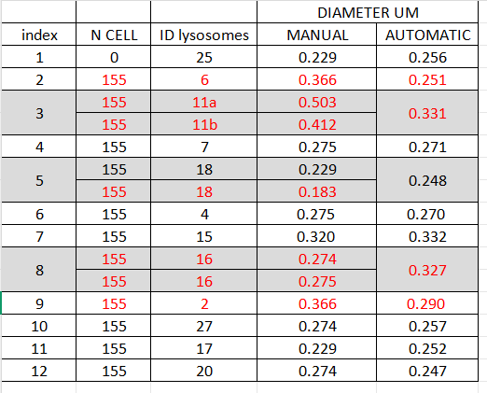
40A_UAS-TMEM1923x-HA x 71G10 40A MARCM_L3_1_Airy_010724

Slide 24
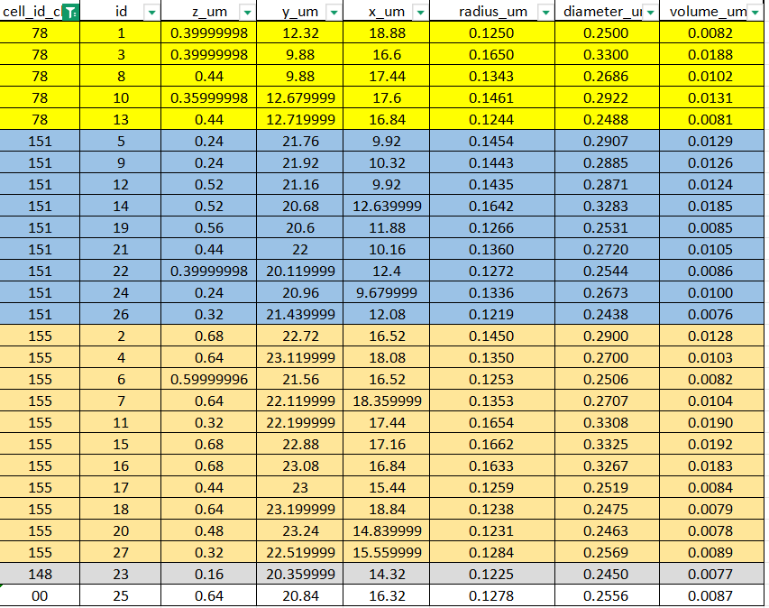
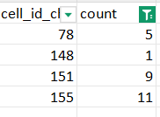
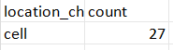
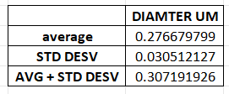
40A_UAS-TMEM1923x-HA x 71G10 40A MARCM_L3_1_Airy_010724

